Slide 1
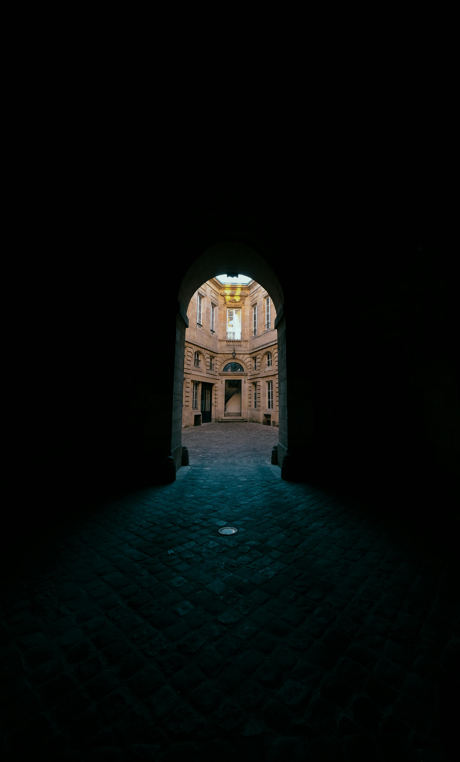
ables.com.my
Apr 2025
ZakatChain
Transparent, Trustless Charity for the Ummah
Notes:
Good morning ladies and gentlemen, I am Lee Wei Song, team leader of ABLEs.

Slide 2
The Problem
Do you know where your zakat goes?

Slide 3
All Muslims need to give zakat.

Slide 4
But do they know where it truly goes?

Slide 5
Muslim
+
🧍 Poor People (Fuqaraa) 👥 Needy People (Masakeen) 🤝 Zakat Collector (Aamileen) ❤️ Those Who have a Reconciliation of Heart (Muallafatul Quloob) 🧘 To Free those in Bondage (Ar-Riqaab) 💸 The Debt-Ridden (Al Ghaarimeen) 🌍 For the Cause of God (Fi Sabeelillah) 🚶 Wayfarer

Slide 6

How to let donors track their donation from start to end — ensuring it reaches those who need it most?
Notes:
They are the blinds and visually impaired individuals who often failed to understand the content of online videos, not to mention enjoying it. For blinds, they need audio descriptions to get better understanding on the content of video.

Slide 7

The Solution
A blockchain-powered platform to track, verify, and fulfil zakat donations in real-time.

Slide 8

VISION AND VALUE PROPOSITION
At ZakatChain, we are using blockchain and IPFS to verify recipients, organizations, track donations, and confirm fulfillment — all on-chain.
Join us in changing charity for everyone.
Notes:
At Enjoyable, we're making video accessible to the blind with AI audio description.

Slide 9
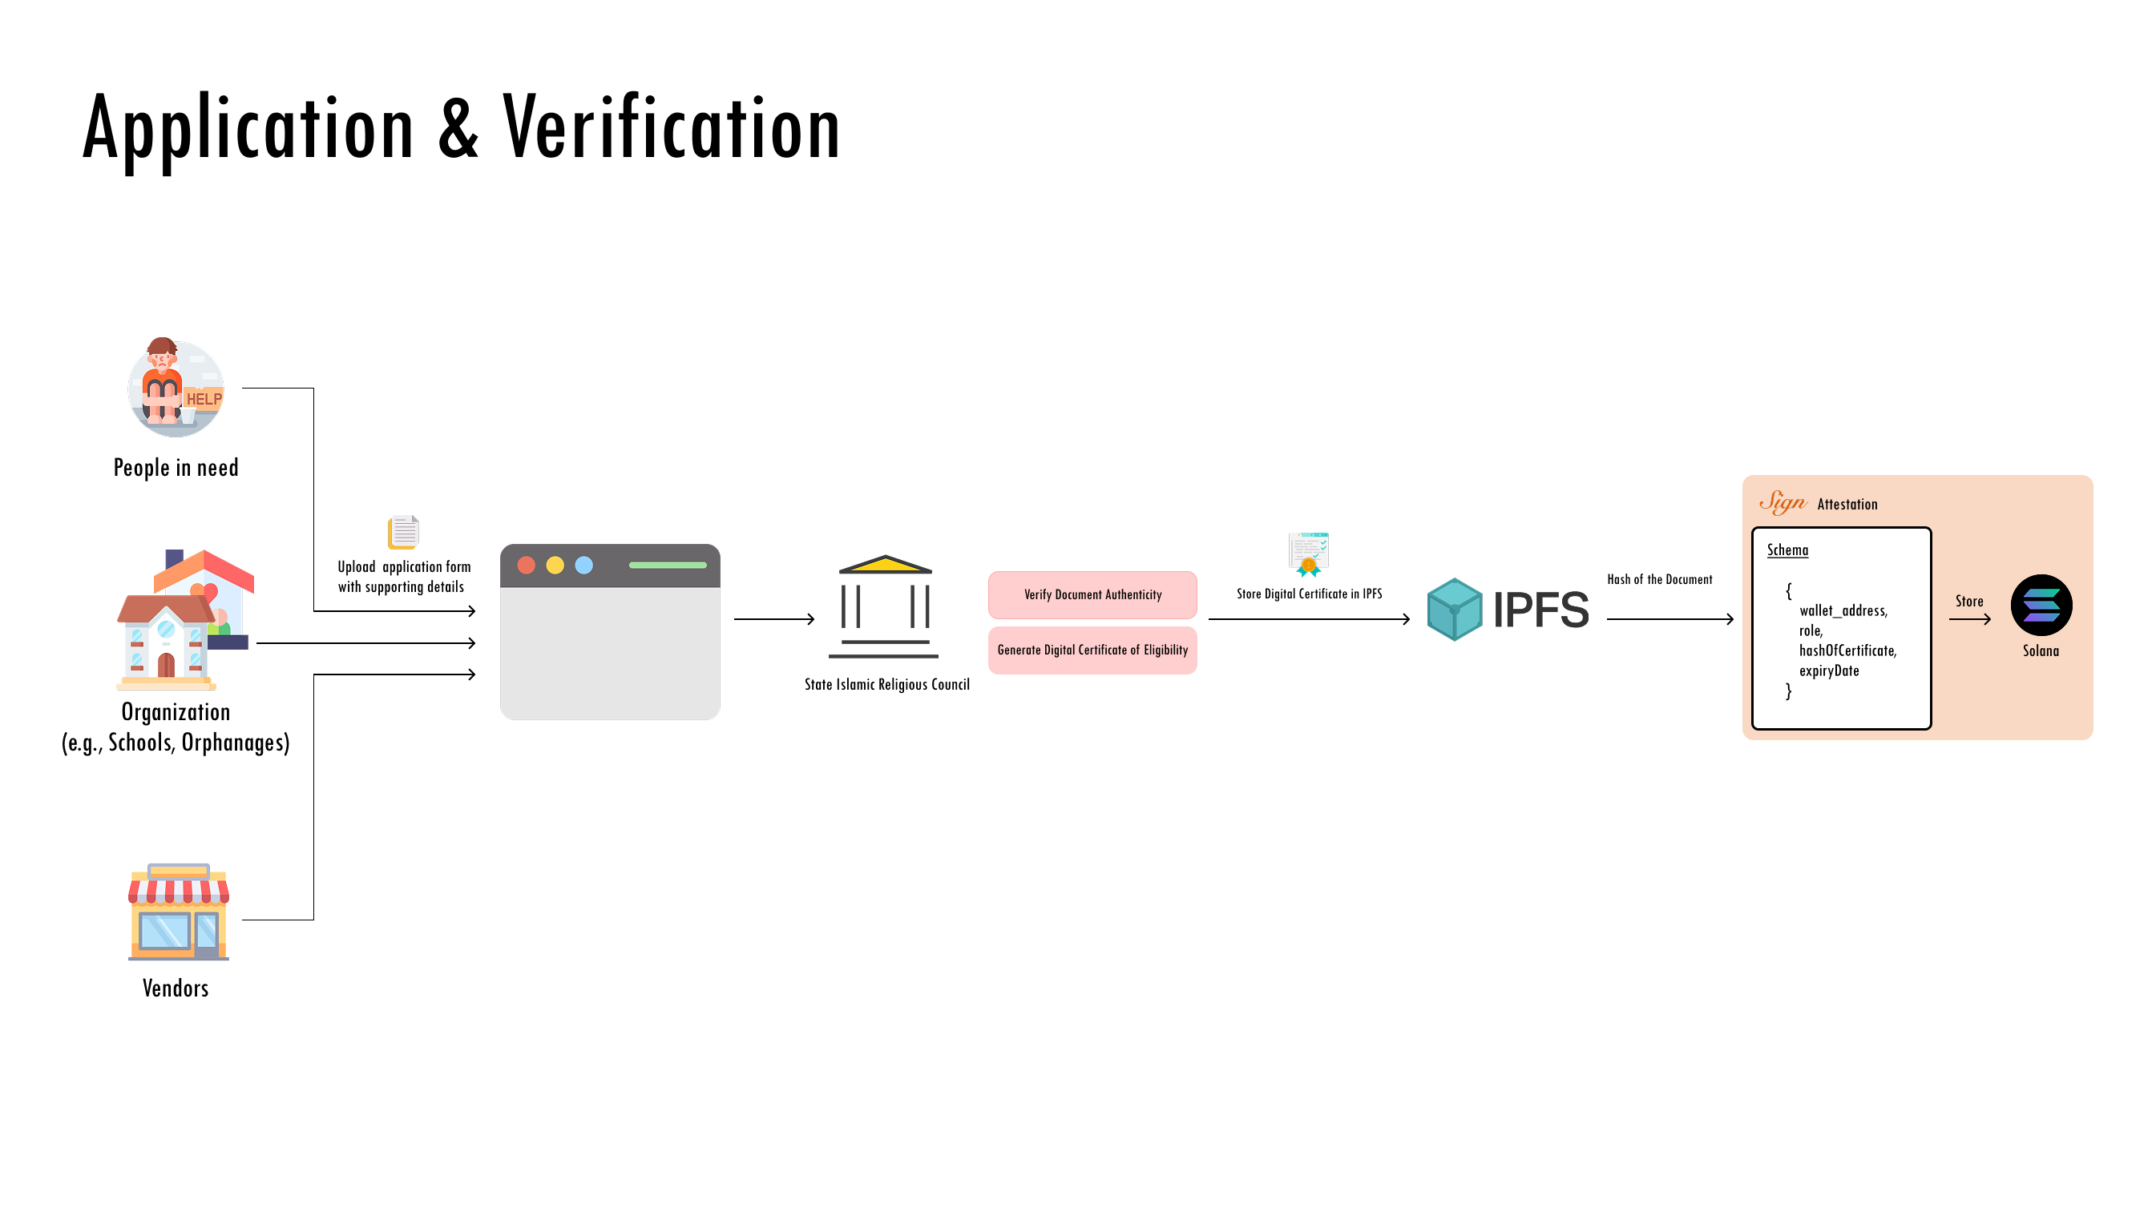

Slide 10
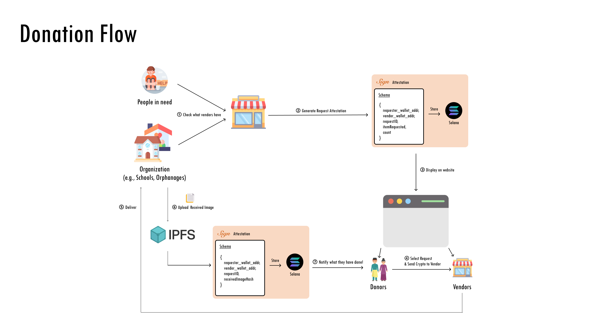

Slide 11
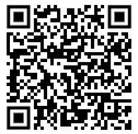
ZakatChain – Figma Prototype Link
https://www.figma.com/proto/OsPTsVhqHyUo1Ubggc55cK/ZakatChain?node-id=0-1&t=vBWnpHgZtbfsuEwD-1

Slide 12
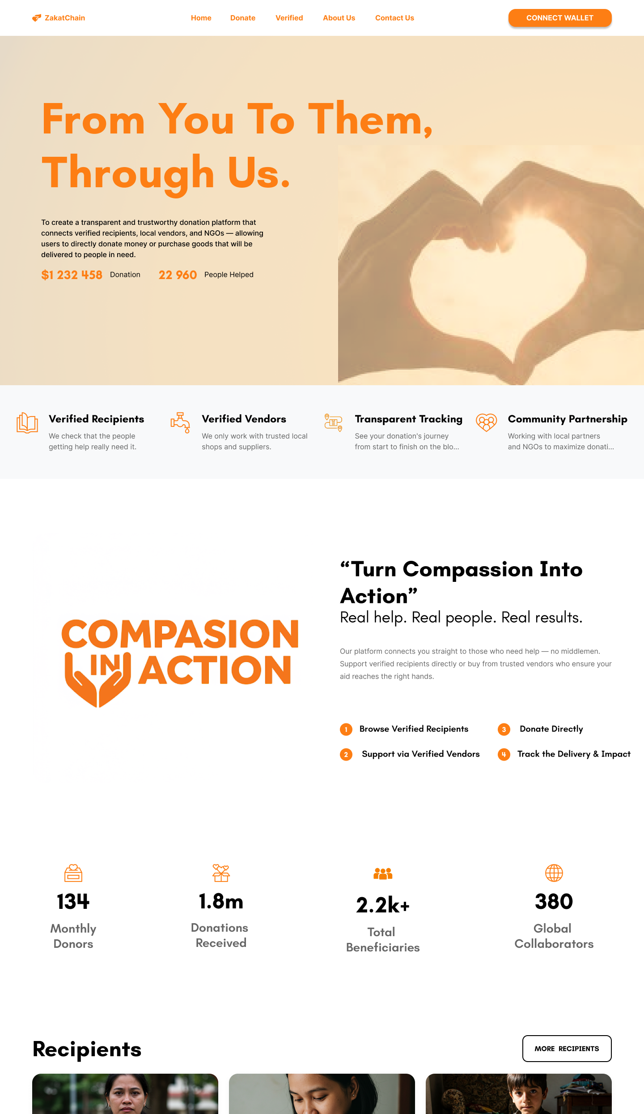
ZakatChain - HomePage
#FD7E14
#000000
#FFFFFF
Orange Background + Negative Appeal (Effective Pair)
Choi, Jungsil & Li, Yexin Jessica & Rangan, Priyamvadha & Yin, Bingqing & Singh, Surendra N., 2020. "Opposites attract: Impact of background color on effectiveness of emotional charity appeals," International Journal of Research in Marketing, Elsevier, vol. 37(3), pages 644-660.

Slide 13
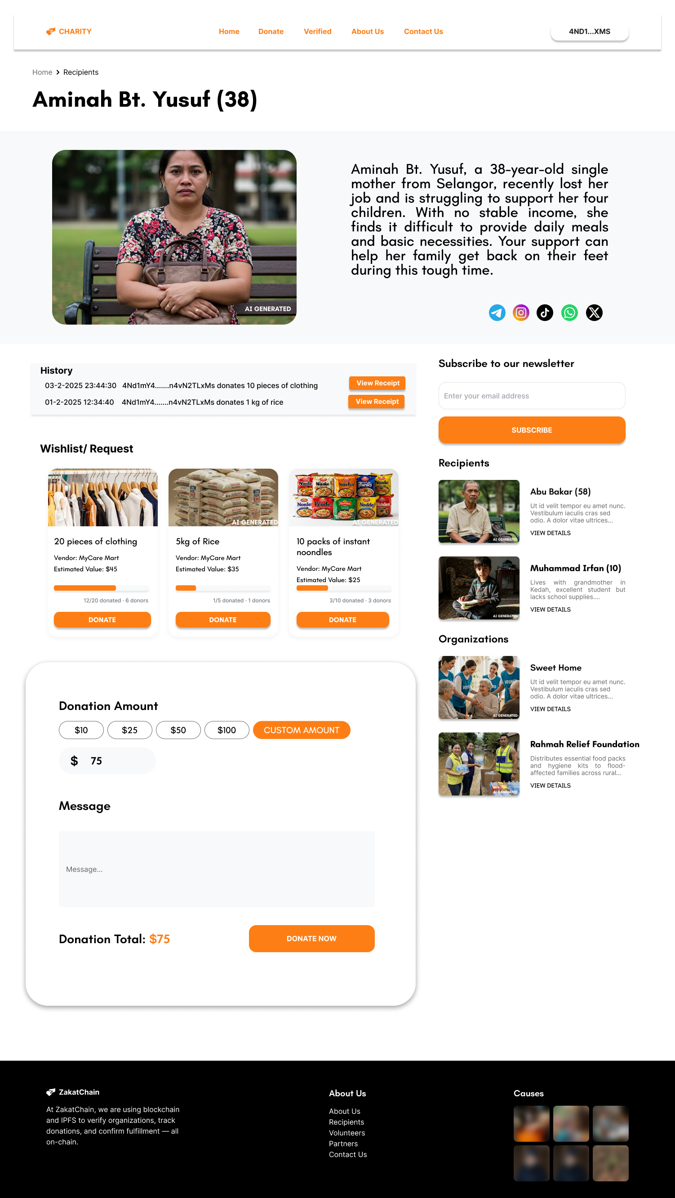
When donors want to donate to
verified recipients/organizations

Slide 14
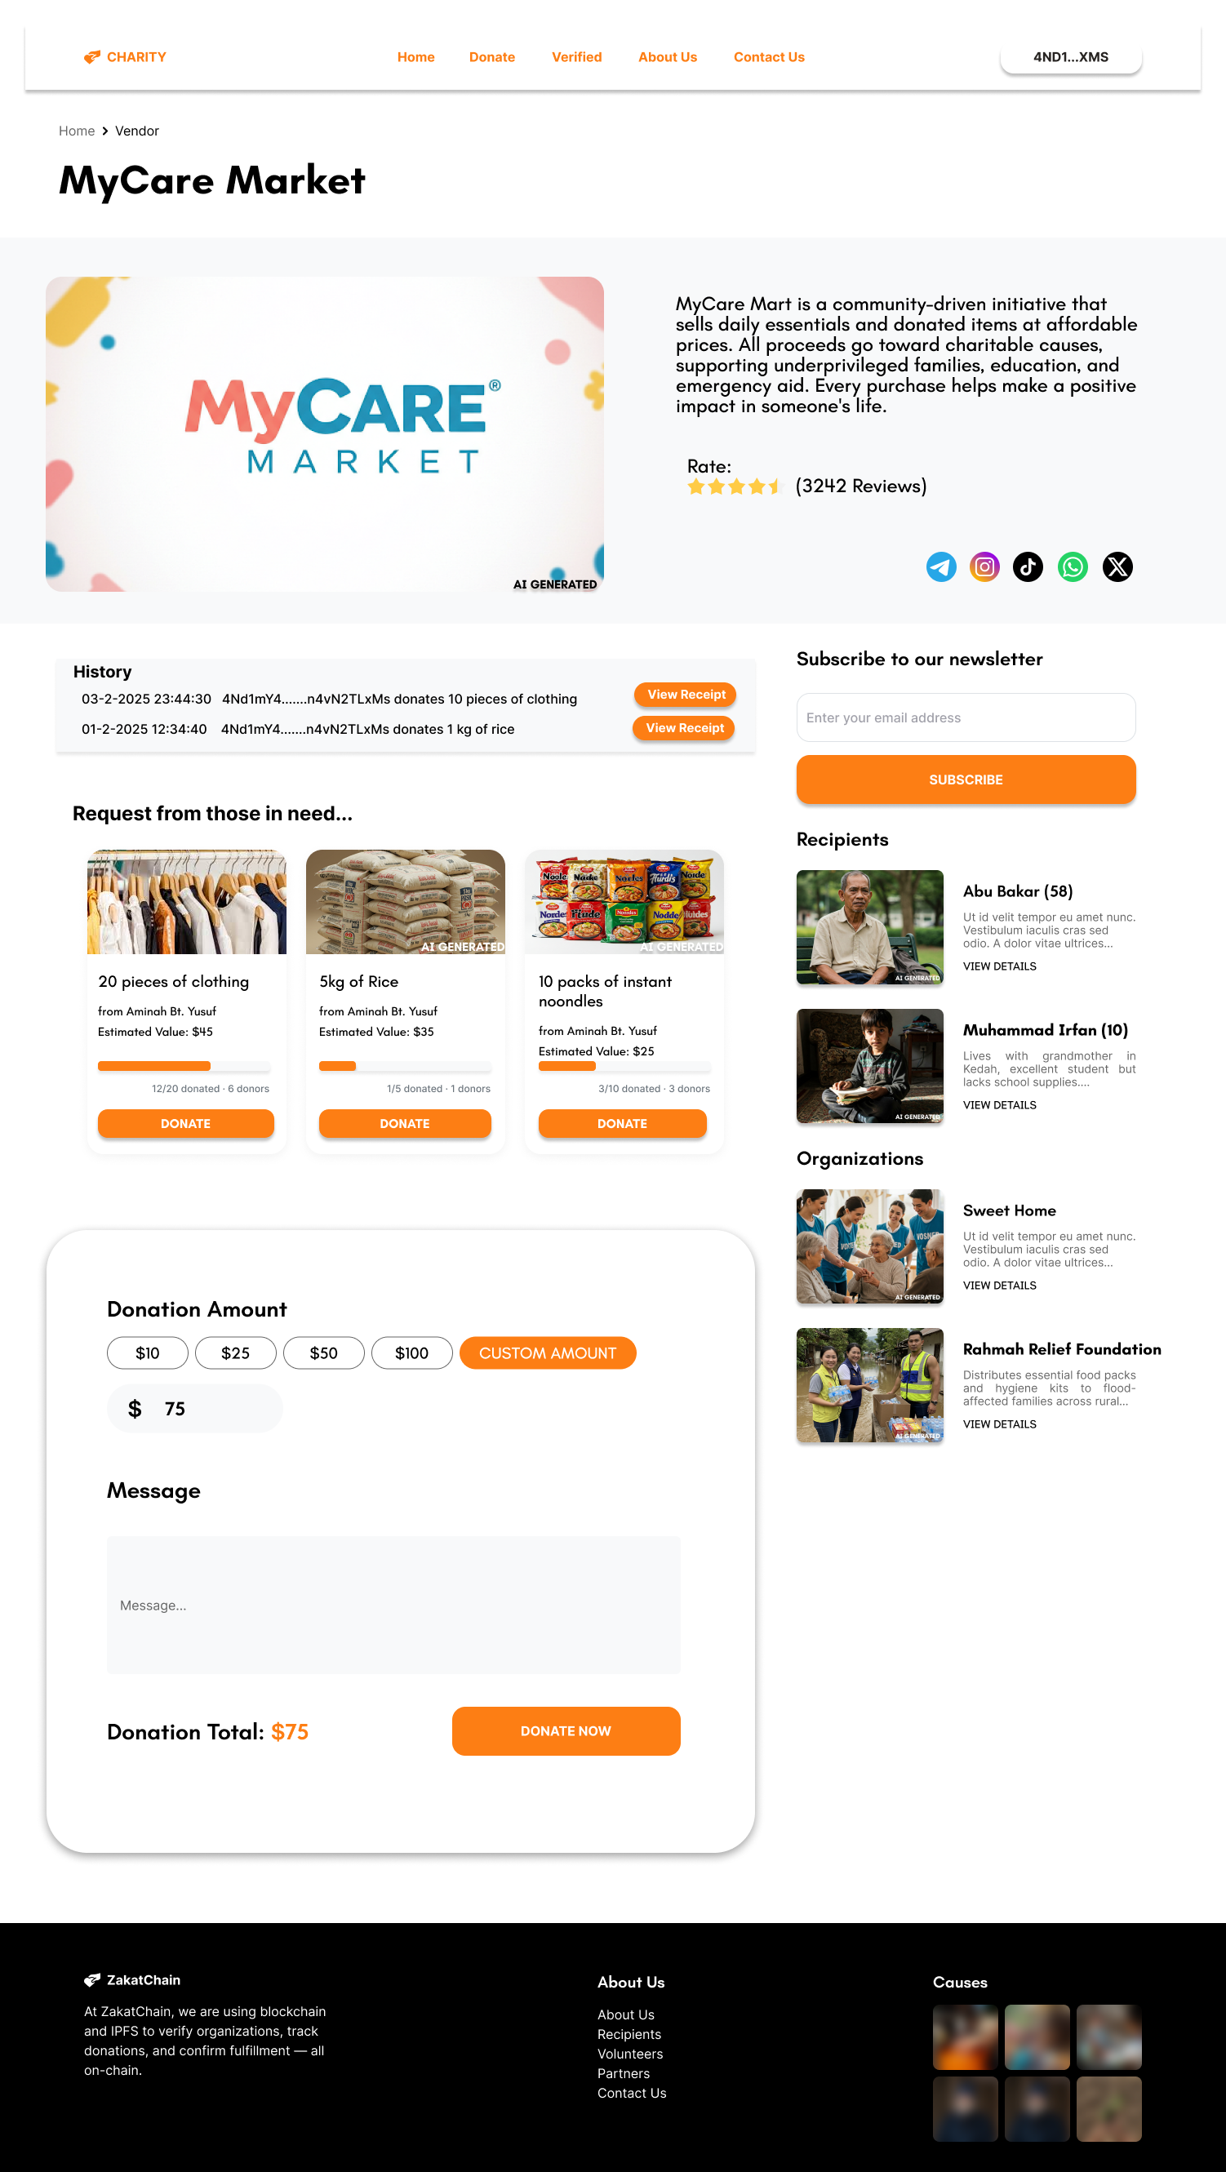
When donors want to check
verified vendor details

Slide 15
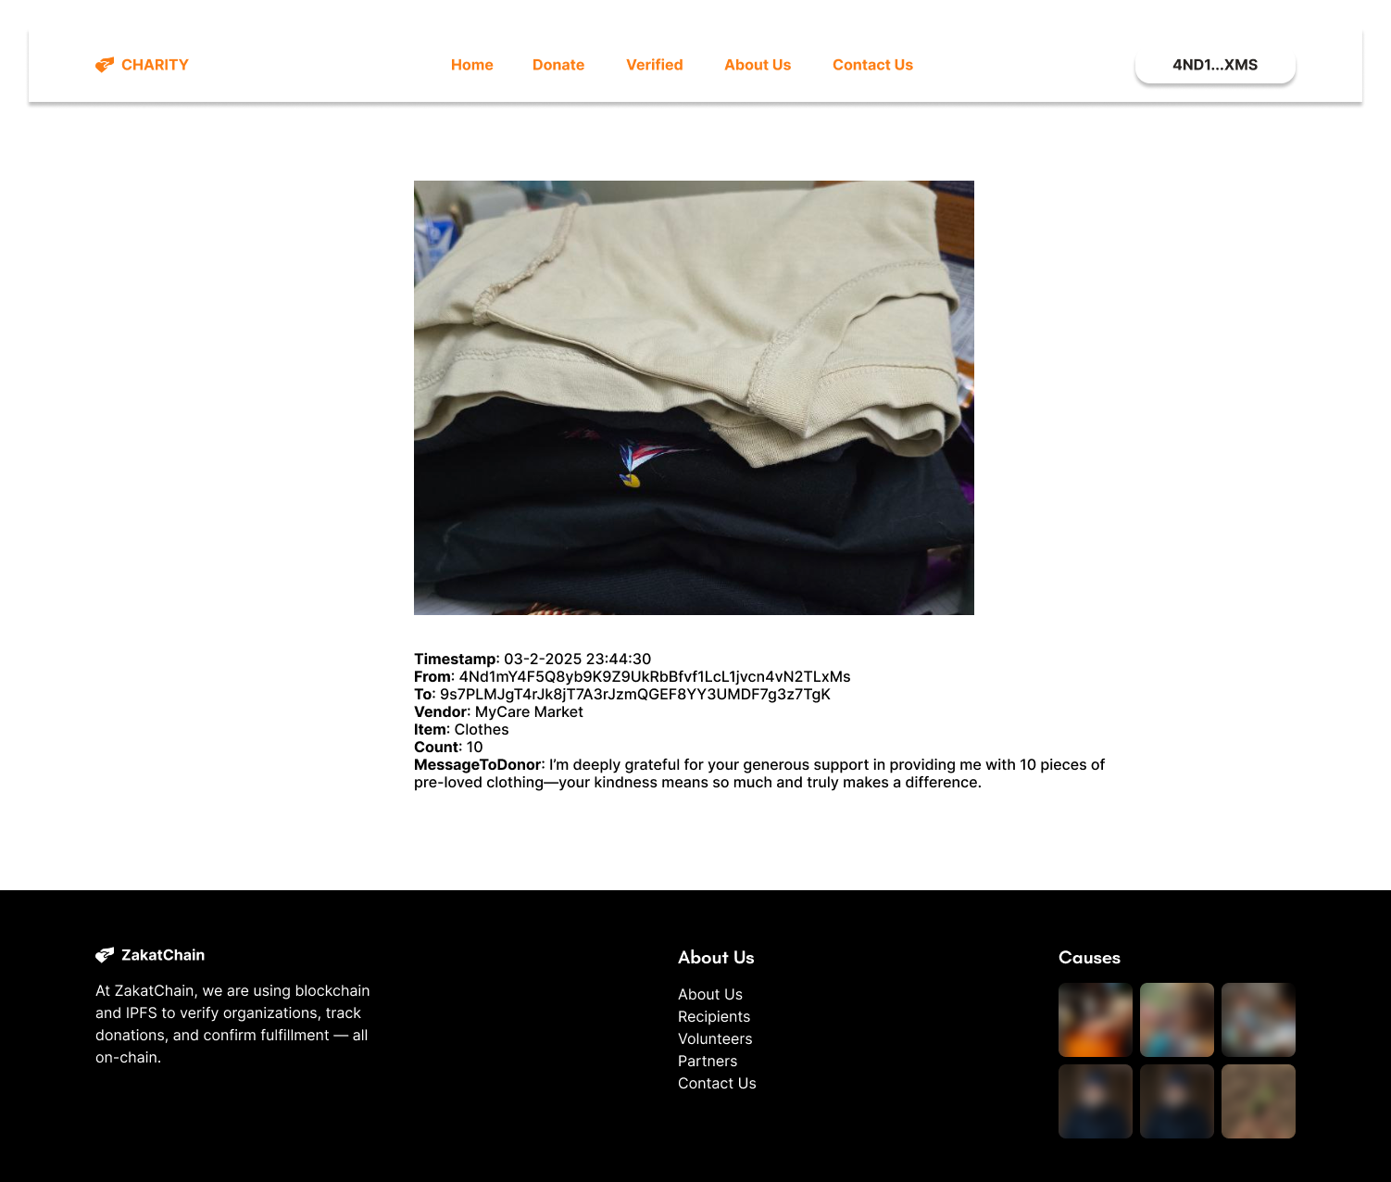
When donors want to check receipts

Slide 16
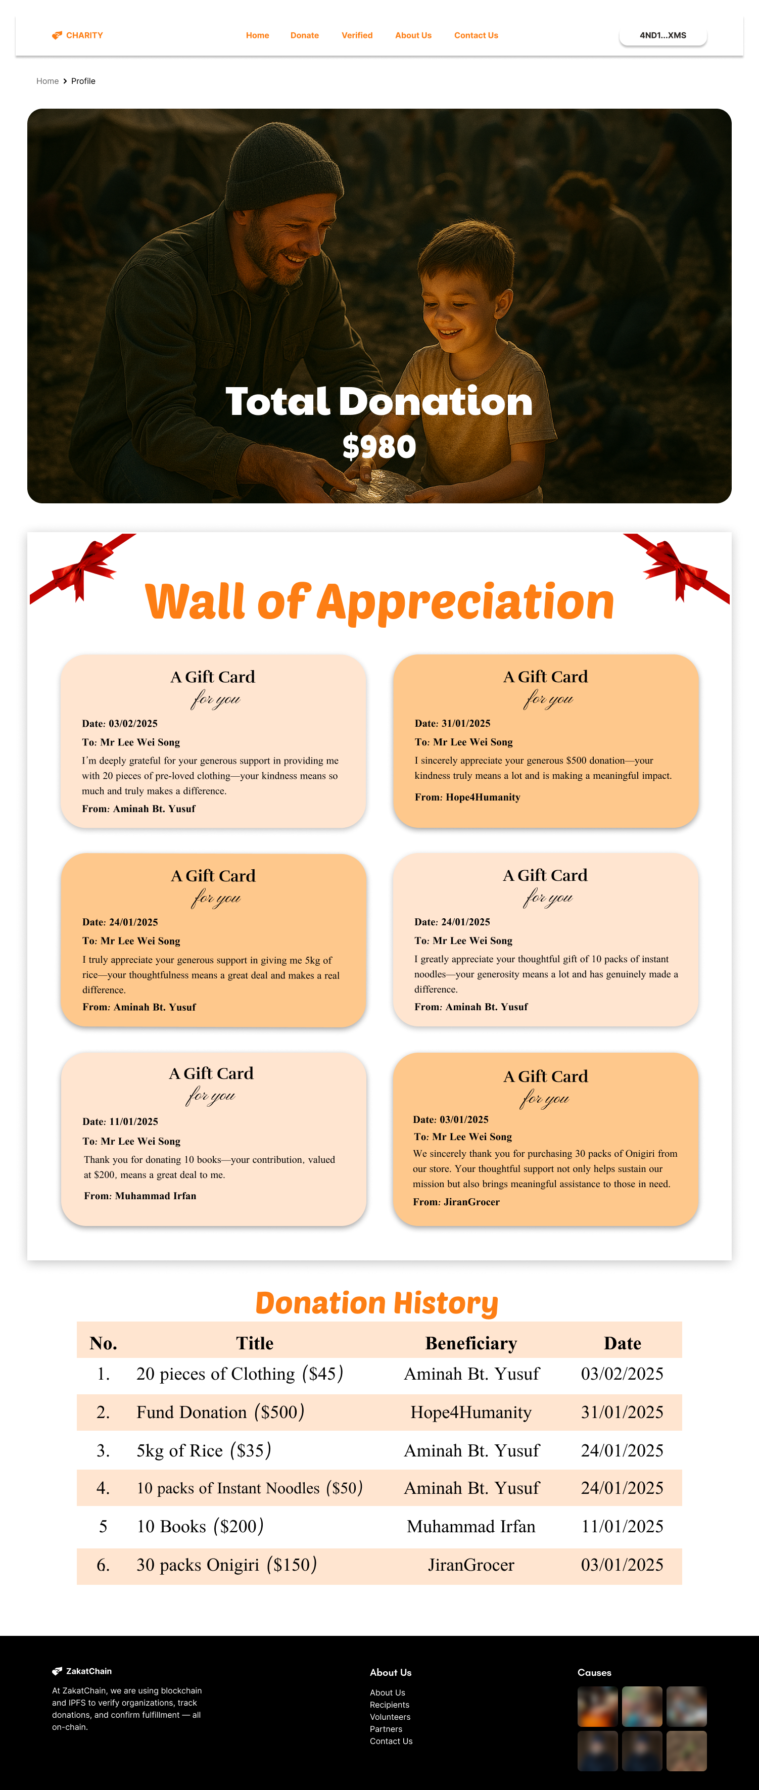
When donors want to view his/her profile

Slide 17
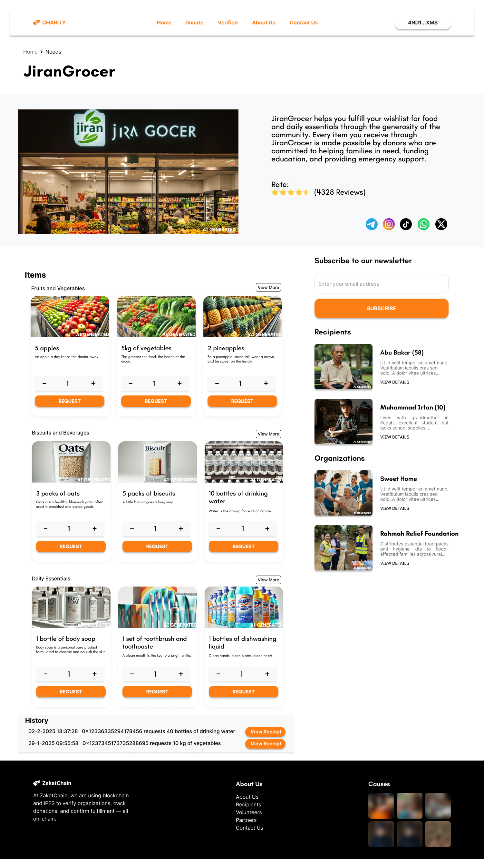
When verified recipients/organizations
want to make a request

Slide 18
ZakatChain
From Donation to Delivery: Zakat, Verified.
Notes:
That’s all from us, thank you everyone, have a nice day!

Slide 19



Team Info
ABLEs
Here, we make dreams, we sell dreams.
www.ables.com.my
info@ables.com.my
011-37885223

